Slide 1
Digital Signal Processing
Dr. Ahmad Salman
SEECS
Content and Figures are from Discrete-Time Signal Processing, 2e by Oppenheim, Shafer, and Buck, ©1999-2000 Prentice Hall Inc.

Slide 2
Course Objectives
Objective :Develop intermediate and advanced understanding of Digital Signal Processing Theory and Applications
  A natural extension of Signals and Systems
  Know the fundamental signal processing tools
  Know how and where to use which tool
  Develop a mathematical foundation for advanced signal processing techniques

Slide 3
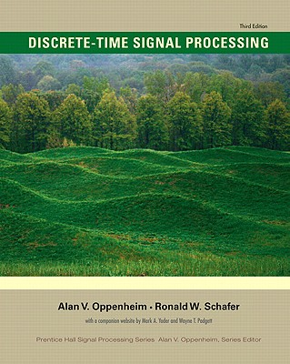
Course Books
Required Text
Discrete-Time Signal Processing, 3rd or later Edition
Prentice Hall, Alan Oppenheim, Ronald Schafer
Lecture Notes
References
Schaum’s Outlines: Digital Signal Processing
M. H. Hayes (Practice Problems)
Understanding DSP-Lyons (2nd Edition)
DSP-System analysis and design
Paulo S. R. Diniz et al.
MATLAB Exercises
Signal Processing First J. H. McClellan et al.
Digital Signal Processing-A computer based approach –Mitra
Unlimited resources on internet

Slide 4
DSP Where !
DSP is Everywhere

Slide 5
DSP Where !
Any information in nature exist in the form of some signal e.g., sound, purely electrical signal, EM signal, purely chemical signal, purely mechanical signal OR combination of any of these…
Do you believe there must be some ONE and ONLY god signal?
Our aim is to visualize these signals and extract the information of interest i.e., do some processing on these signals.
So Signal Processing is Father of all Engineering Processing as it tells you the basic structure and nature of a signal.

Slide 6
DSP Where !
Remember this figure throughout your signal processing life.
There are two side of mirror and hence the above figure
  Time side
  Frequency side
Input Signal
Output Signal
Process

Slide 7
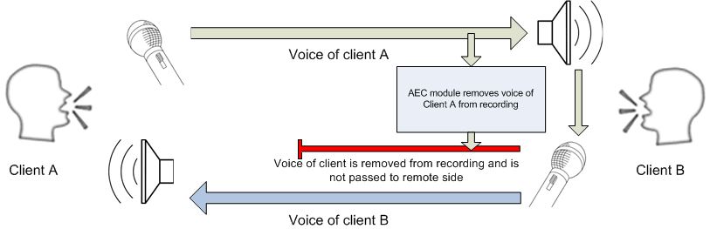
DSP Where !
Communication – Signal Processing for Communication
  Equalization, Channel Estimation, Echo cancellation, Detection, etc.
  Cellular phones, Satellite receivers, Modems, etc.
Courtesy : Lake of Soft

Slide 8
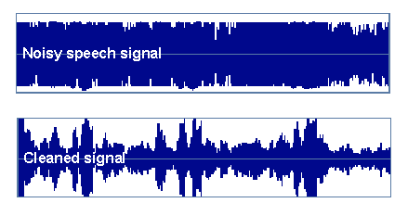
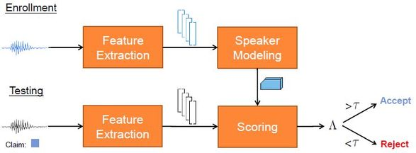
DSP Where !
Speech (sound) Applications
  Speech compression, speaker identification, speech enhancement in noisy environment, special effects
  Cell Phones, MP3 Players, Movies, Dictation, Text-to-speech,…
Speaker Recognition
Speech enhancement

Slide 9



DSP Where !
Speech (sound) Applications
  Speech compression, speaker identification, speech enhancement in noisy environment, special effects
  Cell Phones, MP3 Players, Movies, Dictation, Text-to-speech,…

Slide 10
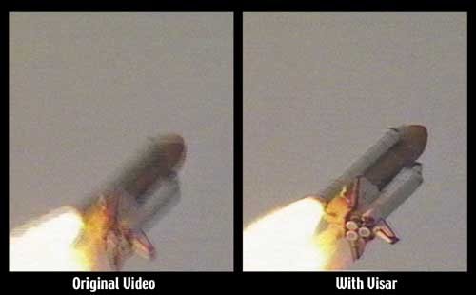
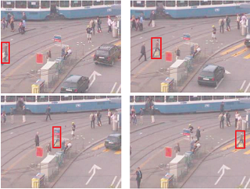
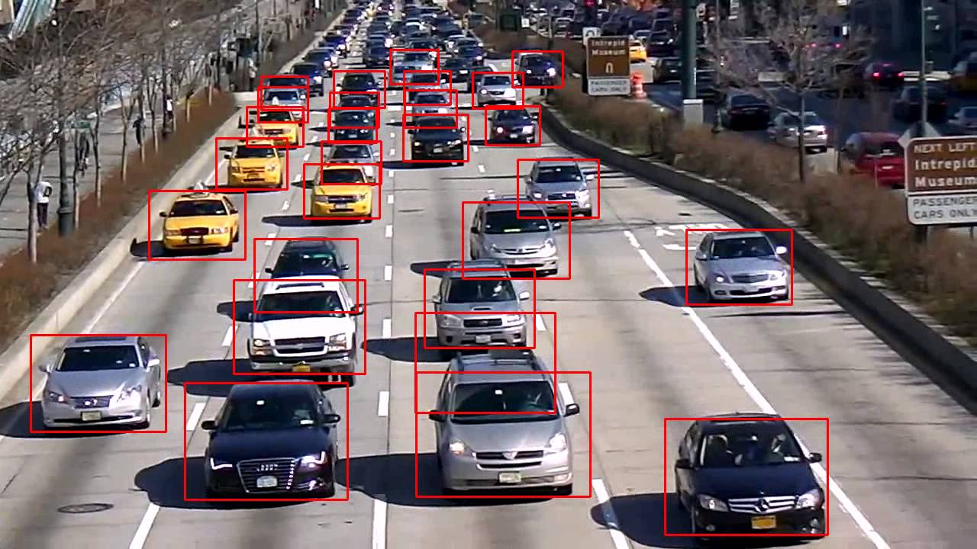
DSP Where !
Image Processing
  Image is after all a 2-D signal
Raw Image
Filtered Image
Pedestrian tracking
Vehicle tracking

Slide 11
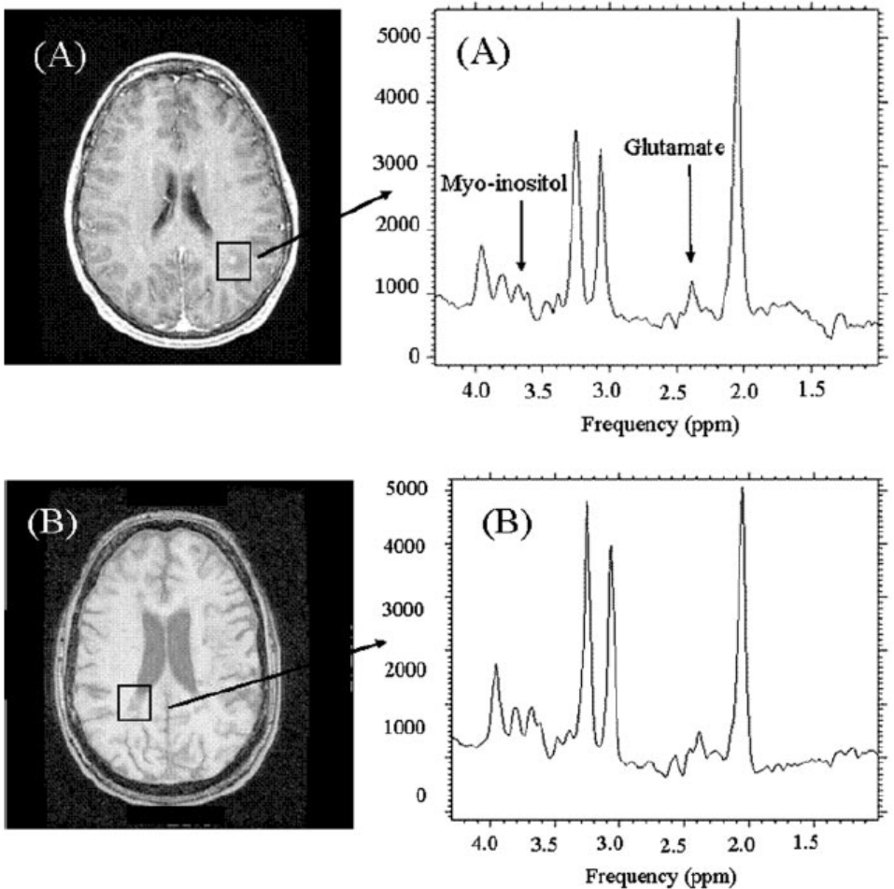
DSP Where !
Biomedical Signal Processing
  Magnetic Resonance, Tomography, Electrocardiogram,…

Slide 12
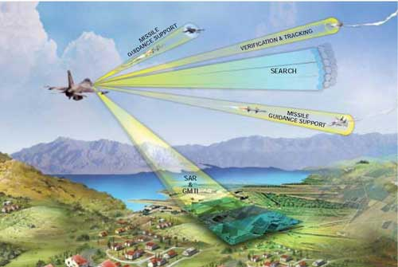
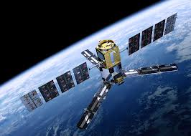
DSP Where !
Military
  Radar, Sonar, Space photographs, remote sensing

Slide 13
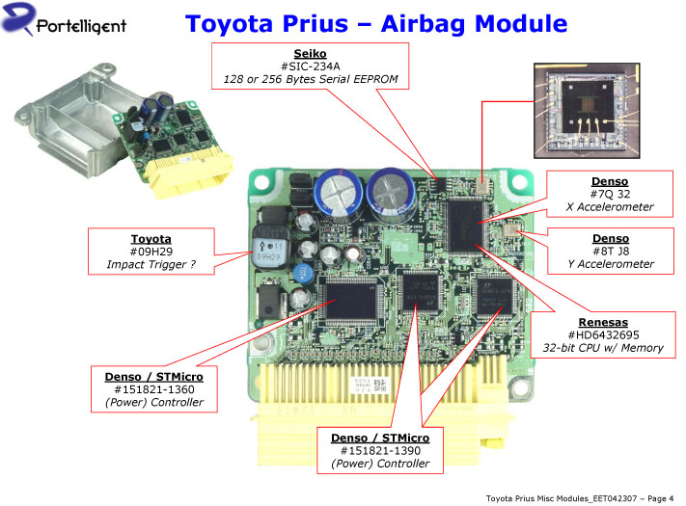
DSP Where !
Mechanical
  Motor control, process control, oil and mineral prospecting,…
Automotive
  ABS, GPS, Active Noise Cancellation, Cruise Control, Parking,…

Slide 14
Course Outline
Review Should take no more than 2 sessions
  Discrete-Time Signals and System
    Discrete-Time Signals: Sequences
    Discrete-Time Systems
  Linear Time-Invariant Systems
    Properties of Linear Time-Invariant Systems
    Linear Constant-Coefficient Difference Equations
  Freq. Domain Representation of Discrete-Time Signals
    Representation of Sequences by Fourier Transforms
    Symmetry Properties of the Fourier Transform
    Fourier Transform Theorems
  Z-Transform 1-2 sessions
    Properties of the Region of Convergence of the z-Transform
    The Inverse Z-Transform
    Z-Transform Properties

Slide 15
Course Outline
Sampling of Continuous-Time Signals
- Periodic (Uniform) Sampling / Frequency-Domain Representation
  - Reconstruction of a Bandlimited Signal from Its Samples
  - Discrete time processing of continuous time signals
  - Continuous time processing of discrete time signals
Transform Analysis of Linear Time-Invariant Systems Optional
  The Frequency Response of LTI Systems
  Constant-Coefficient Difference Equations
  Frequency Response for Rational System Functions
  Relationship between Magnitude and Phase
  All-Pass Systems / Minimum-Phase Systems
Structures for Discrete-Time Systems
- Block Diagram Representation /Signal Flow Graph Representation
  - Basic Structures for IIR Systems / Transposed Forms
  - Basic Structures for FIR Systems

Slide 16
Course Outline
Filter Design Techniques
- Design of Discrete-Time IIR Filters from Continuous-Time Filters
  Design of FIR Filters by Windowing
The Discrete-Fourier Transform & FFT
  Discrete Fourier Series
  The Fourier Transform of Periodic Signals
  The Discrete Fourier Transform
  FFT
Linear Prediction Analysis
  Theory and applications
Power Spectrum Estimation
  Theory and applications

Slide 17
Course Weightages
Theory :
Quizzes (5) 10%
Assignments (2-3) : 5%
  Software
OHTs/Midterm 12.5% + 12.5%
  Written
  Software (Optional)
Final Exam 35%
Labs: 25%

Slide 18
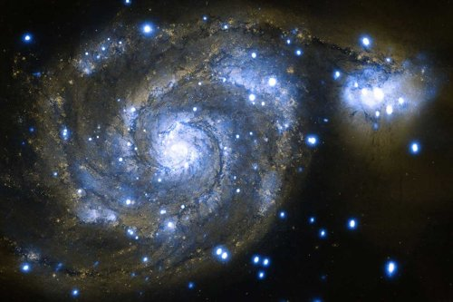

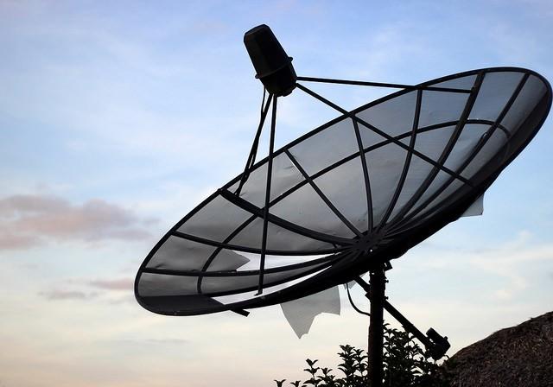
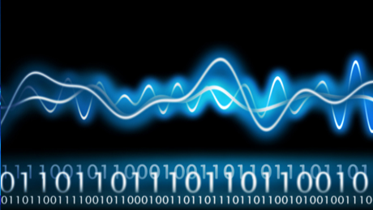
Say Hello to DSP
Signals in nature exist in continuous/analogue form. You can do analogue signal processing.
The aim of using computers for the ease of calculation is digital signal processing.
So understand how to jump from analogue processing to digital processing.
Naturally standalone digital processing is extremely difficult: It like defying nature.
How??

Slide 19
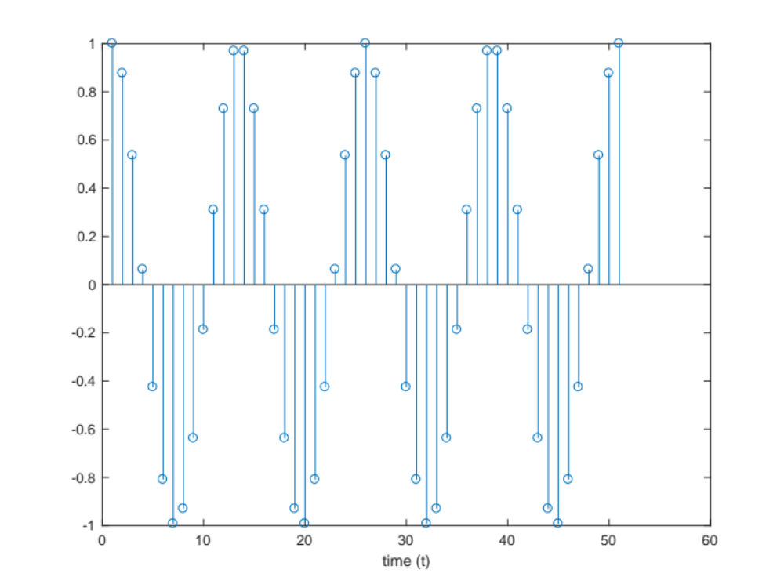
Say Hello to DSP

Slide 20
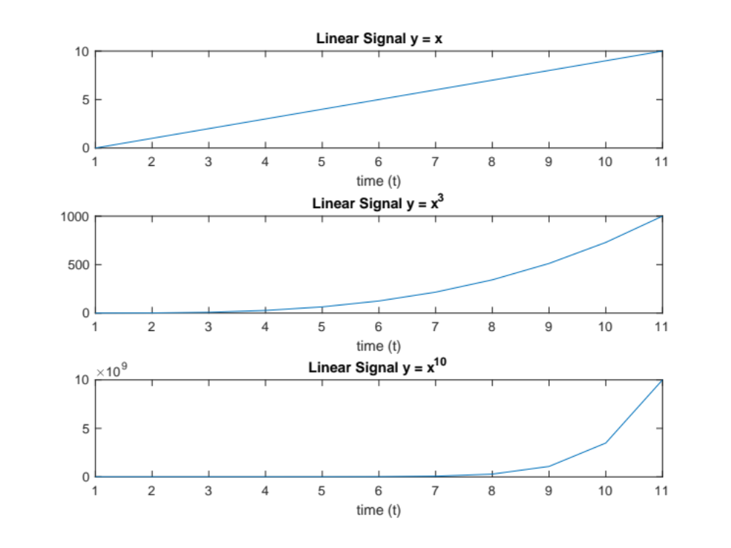
Say Hello to DSP

Slide 21
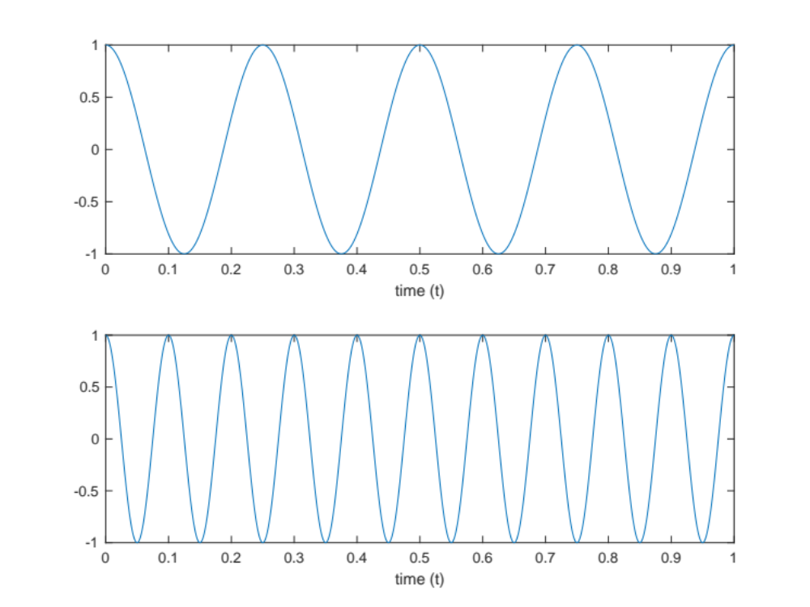
Say Hello to DSP

Slide 22
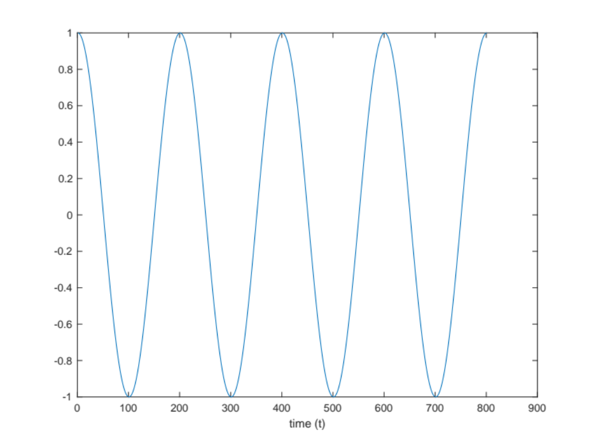
Say Hello to DSP

Slide 23
Discrete-Time Signals: Sequences
Discrete-time signals are represented by sequence of numbers
  The n^{th} number in the sequence is represented with x[n]
Often times sequences are obtained by sampling of continuous-time signals
10
0
-10
t (ms)
0
20
40
60
80
100
10
0
-10
n (samples)
0
10
20
30
40
50

Slide 24

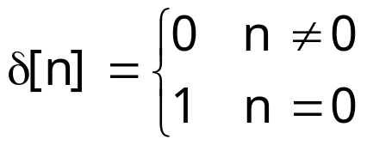
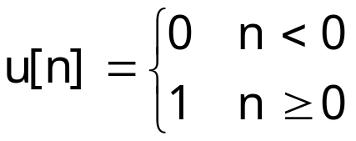

Basic Sequences
Delaying (Shifting) a sequence
Unit sample (impulse) sequence
Unit step sequence
Exponential sequences
1.5
1
0.5
0
-10
-5
0
5
10
1.5
1
0.5
0
-10
-5
0
5
10
1
0.5
0
-10
-5
0
5
10

Slide 25


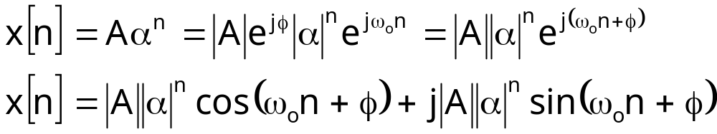
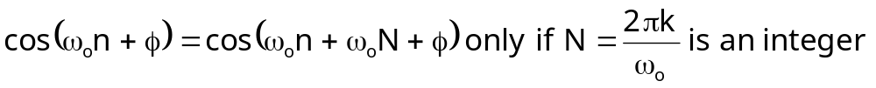
Sinusoidal Sequences
Important class of sequences
An exponential sequence with complex
x[n] is a sum of weighted sinusoids
Different from continuous-time, the discrete-time sinusoids
  Have ambiguity of 2πk in frequency

